Slide 1



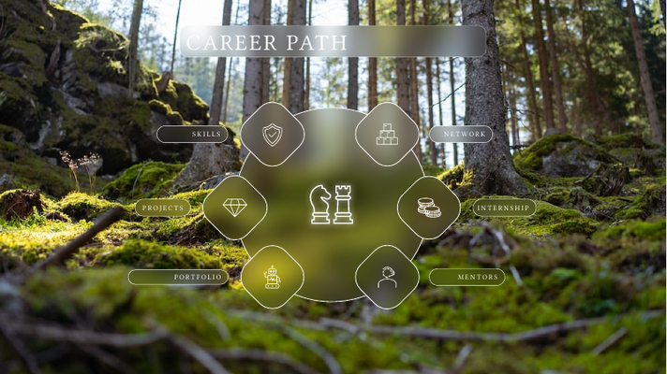
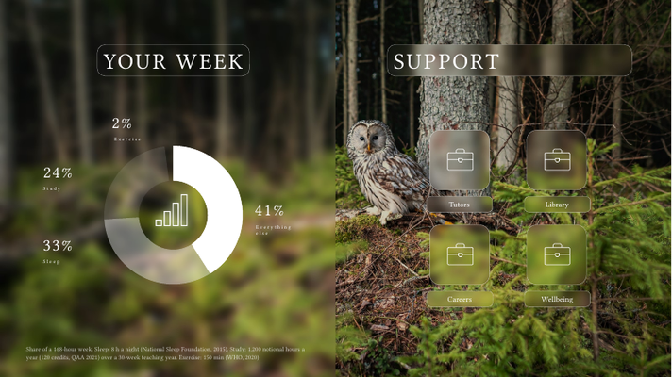
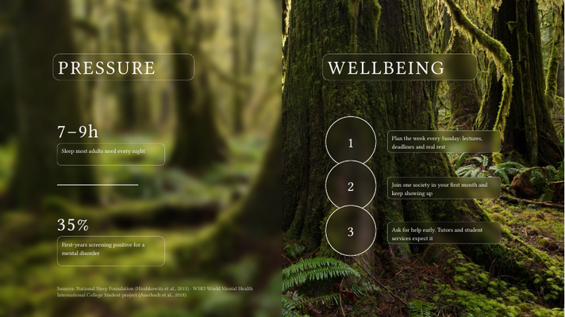
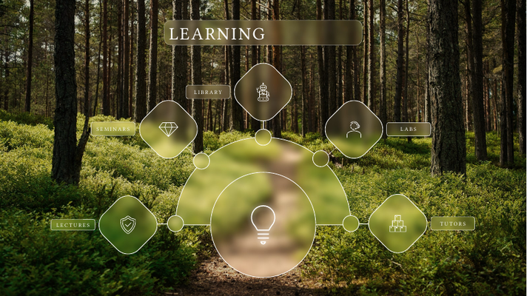





UNIVERSITY LIFE
A FIELD GUIDE FOR NEW STUDENTS
SUPERVISOR
Shawan Sayid Haji
PREPARED AND PRESENTED BY
Twana Farooq
Hardi Rahman
ENGLISH DEPARTMENT · FACULTY OF ARTS · SORAN UNIVERSITY
Notes:
OPENING (auto)
Welcome everyone. Introduce yourselves: Twana Farooq and Hardi Rahman, supervised by Shawan Sayid Haji, English Department, Faculty of Arts, Soran University.
One line: today we walk through what university life really asks of you, and where to find help.
Press Next to open the menu.

Slide 2
UNIVERSITY LIFE
A FIELD GUIDE FOR NEW STUDENTS
LEARNING
How study changes, and where to get help.
YOUR WEEK
Where 168 hours go, and the support around you.
WELLBEING
Pressure is normal. Habits that protect you.
CAREER PATH
From campus to your first job.
LEARNING
YOUR WEEK
WELLBEING
CAREER
PATH
Notes:
MENU (4 clicks)
Each Next brings in one topic icon: Learning, Your week, Wellbeing, Career path.
Tip: click any icon to show a short summary card; click the card to close it.
After the fourth icon, Next lights up the first topic.

Slide 3
UNIVERSITY LIFE
A FIELD GUIDE FOR NEW STUDENTS
LEARNING
YOUR WEEK
WELLBEING
CAREER
PATH
Notes:
MENU, LEARNING HIGHLIGHTED
"First, how learning changes." Press Next and the card grows into the Learning slide.

Slide 4






LEARNING
LEARNING
At university you move from being taught to teaching yourself.
01 / 05 LECTURES
Large-group teaching that maps the whole module. Write notes, then rewrite them the same week.
02 / 05 LIBRARY
Quiet study space, research databases and librarians who help you find good sources.
03 / 05 SEMINARS
Small-group discussion. Read before you arrive and bring one question.
04 / 05 TUTORS
Your academic advisers. Use office hours early, not only before exams.
05 / 05 LABS
Hands-on practice where theory becomes a skill. Record every session.
  LIBRARY
  SEMINARS
  LABS
  LECTURES
  TUTORS
Notes:
LEARNING (5 clicks)
Opening line: at university you move from being taught to teaching yourself.
Each Next adds one place you learn: lectures, seminars, library, labs, tutors.
The detail panel at top left changes with every click: read it or say it in your own words.
Photo credit: https://unsplash.com/photos/H8vhhepiiaU

Slide 5
UNIVERSITY LIFE
A FIELD GUIDE FOR NEW STUDENTS
YOUR WEEK
LEARNING
WELLBEING
CAREER
PATH
Notes:
MENU, YOUR WEEK HIGHLIGHTED
"Next, where your time actually goes."

Slide 6



YOUR WEEK
SUPPORT
01 / 05 YOUR WEEK
A week has 168 hours. Sleep and study take more than half of them. Exercise needs only 2%.
2%
Exercise
24%
Study
41%
Tutors
Library
Everything else
33%
Sleep
Careers
Wellbeing
02 / 05 TUTORS
First stop for questions about modules, deadlines and feedback.
03 / 05 LIBRARY
Study rooms, research help and academic-writing support.
04 / 05 CAREERS
CV reviews, internship listings and interview practice.
05 / 05 WELLBEING
Confidential counselling and support when pressure builds.
Share of a 168-hour week. Sleep: 8 h a night (National Sleep Foundation, 2015). Study: 1,200 notional hours a year (120 credits, QAA 2021) over a 30-week teaching year. Exercise: 150 min (WHO, 2020)
Notes:
YOUR WEEK (5 clicks)
Click 1: the 168-hour week. Sleep is about a third, study about a quarter, exercise only 2%.
Say where the numbers come from: National Sleep Foundation, QAA credit framework, WHO 2020 (footnote).
Clicks 2-5: four support services; the panel at bottom right says what each one does.
Photo credit: https://unsplash.com/photos/c-YzuJ6Q6jk

Slide 7
UNIVERSITY LIFE
A FIELD GUIDE FOR NEW STUDENTS
WELLBEING
LEARNING
YOUR WEEK
CAREER
PATH
Notes:
MENU, WELLBEING HIGHLIGHTED
"Now the part nobody puts on the timetable: pressure."

Slide 8


PRESSURE
WELLBEING
7–9h
01 / 05 SLEEP
Keep one wake-up time every day, weekends included.
1
02 / 05 ASK EARLY
Counselling exists for exactly this. Asking early is a strength.
Plan the week every Sunday: lectures, deadlines and real rest
Sleep most adults need every night
2
Join one society in your first month and keep showing up
35%
3
Ask for help early. Tutors and student services expect it
First-years screening positive for a mental disorder
03 / 05 PLAN
Put lectures, deadlines and rest in one calendar. Rest is a task too.
04 / 05 BELONG
One society, club or team gives you friends outside your course.
05 / 05 HELP
Tutors expect questions. Office hours exist for you to use.
Sources: National Sleep Foundation (Hirshkowitz et al., 2015) · WHO World Mental Health International College Student project (Auerbach et al., 2018)
Notes:
PRESSURE AND WELLBEING (5 clicks)
7-9 hours: the National Sleep Foundation range for 18-25 year olds.
35%: first-year students who screened positive for a common mental disorder in the WHO student survey (Auerbach et al., 2018). Say it calmly: you are not alone.
Then three habits. Each click brings a practical tip panel.
Photo credit: https://unsplash.com/photos/80VEluDXWos

Slide 9
UNIVERSITY LIFE
A FIELD GUIDE FOR NEW STUDENTS
CAREER
PATH
LEARNING
YOUR WEEK
WELLBEING
Notes:
MENU, CAREER PATH HIGHLIGHTED
"Finally, how all of this turns into a career."

Slide 10



CAREER PATH
CAREER PATH
Plan your career like a strategy game: one deliberate move each year.
01 / 06 PROJECTS
Coursework you can show: essays, presentations and research.
02 / 06 SKILLS
Nearly 90% of employers look for problem-solving on a resume (NACE, 2024).
03 / 06 PORTFOLIO
Keep your best work in one place and update it every term.
04 / 06 INTERNSHIP
Paid interns averaged 1.61 job offers; students without one, 0.77 (NACE, 2022).
05 / 06 NETWORK
Classmates, lecturers and alumni open more doors than job boards.
06 / 06 MENTORS
One experienced guide can save you years of trial and error.
  SKILLS
  NETWORK
  PROJECTS
  INTERNSHIP
  PORTFOLIO
  MENTORS
Notes:
CAREER PATH (6 clicks)
One move each year: skills, network, projects, internship, portfolio, mentors.
Each click adds one icon and its tip panel; skills and internship tips carry NACE figures.
Photo credit: https://unsplash.com/photos/kccyPqZezm0

Slide 11
WORK
CAREER
40%
01 / 05 WORKING STUDENTS
Keep paid hours at a level that still leaves time to study and sleep.
1
02 / 05 PROBLEM-SOLVING
Prove it with examples: a project you rescued, a problem you solved.
Paid interns averaged 1.61 job offers, non-interns 0.77
Full-time US undergraduates with a job
2
Nearly 80% of employers look for teamwork skills
~90%
3
Two-thirds also want work ethic and communication
Employers seeking problem-solving skills
03 / 05 INTERNSHIPS
Paid experience before graduation is linked with more job offers (NACE, 2022).
04 / 05 TEAMWORK
Group projects count. Describe your role and the result on your CV.
05 / 05 THE BASICS
Reliability and clear writing get noticed in every interview.
Sources: NCES, The Condition of Education, College Student Employment (2022) · NACE Job Outlook 2024 · NACE Student Survey (2022)
Notes:
WORK AND CAREER (5 clicks)
40%: full-time US undergraduates with a job (NCES, 2020 data).
~90%: employers looking for problem-solving on a resume (NACE Job Outlook 2024).
Paid interns averaged 1.61 offers vs 0.77 for students with no internship (NACE, 2022).
Each click brings the matching tip panel.

Slide 12
SOURCES
EVERY FIGURE, WHERE IT COMES FROM
1. Hirshkowitz, M., et al. (2015). National Sleep Foundation’s sleep time duration recommendations: methodology and results summary. Sleep Health, 1(1), 40–43.
2. Auerbach, R. P., et al. (2018). WHO World Mental Health Surveys International College Student Project: prevalence and distribution of mental disorders. Journal of Abnormal Psychology, 127(7), 623–638.
3. World Health Organization (2020). WHO guidelines on physical activity and sedentary behaviour. Geneva: WHO.
4. Quality Assurance Agency for Higher Education (2021). Higher Education Credit Framework for England. qaa.ac.uk
5. National Center for Education Statistics (2022). College Student Employment. The Condition of Education. nces.ed.gov/programs/coe/indicator/ssa
6. National Association of Colleges and Employers (2023). Job Outlook 2024. naceweb.org
7. National Association of Colleges and Employers (2022). Paid interns/co-ops see greater offer rates and salary offers than their unpaid classmates. naceweb.org
Photography: Unsplash. Individual photo links are in the speaker notes of each slide.
Notes:
SOURCES (auto)
Every figure in this talk comes from these primary publications. Invite the audience to check them.

Slide 13
THANK YOU
QUESTIONS WELCOME
SUPERVISOR
Shawan Sayid Haji
PREPARED AND PRESENTED BY
Twana Farooq
Hardi Rahman
ENGLISH DEPARTMENT · FACULTY OF ARTS · SORAN UNIVERSITY
Notes:
THANK YOU (auto)
Thank the audience and your supervisor. Invite questions.

